Slide 1

Digital Detective: Cybersecurity Case Crackers
Welcome to the Digital Detective challenge, an engaging cybersecurity experience designed for middle school to college students. Participants work in teams of 2 to 4 to solve a digital crime by applying real-world cyber-forensics skills. This immersive challenge lasts 60 to 90 minutes, offering a perfect blend of mystery, puzzle solving, and digital investigation.
Teams will face a fictional hacking incident targeting a school's confidential data. Prepare to dive into a world of fake emails, coded messages, and digital evidence to unmask the perpetrators and understand their tactics.

Slide 2
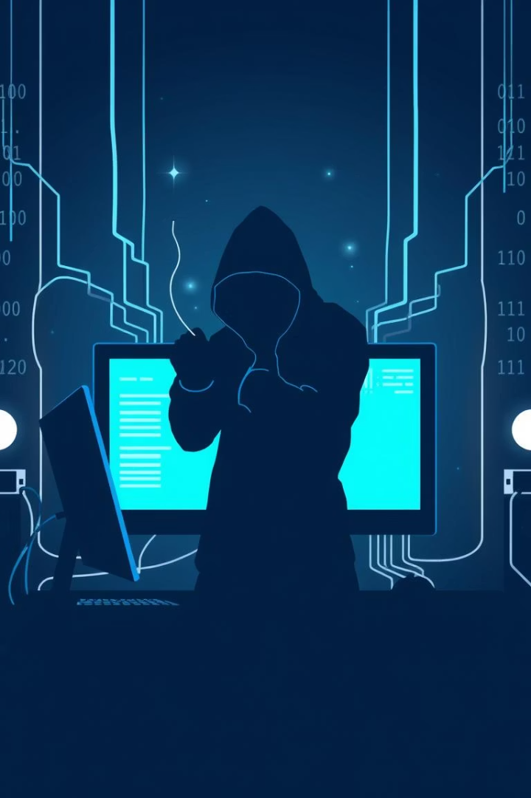
The Crime: School Data Breach
Fictional Scenario
The Culprit
Student records containing names, addresses, and grades have been hacked, compromising personal information.
An unknown hacker group called "NightShade" is suspected of orchestrating the attack.
Investigation Goal
Identify the hacker behind the breach and explain the attack's method and motive.

Slide 3
Step 1: Gather Digital Evidence
Clue Pack Contents
Examples
Fake emails posing as IT support
An email from "IT_Support@school.edu" containing a suspicious link
Chat logs with hacker conversations
Code snippets revealing attack methods
A chat user "ShadowRunner" bragging about the school's hack

Slide 4
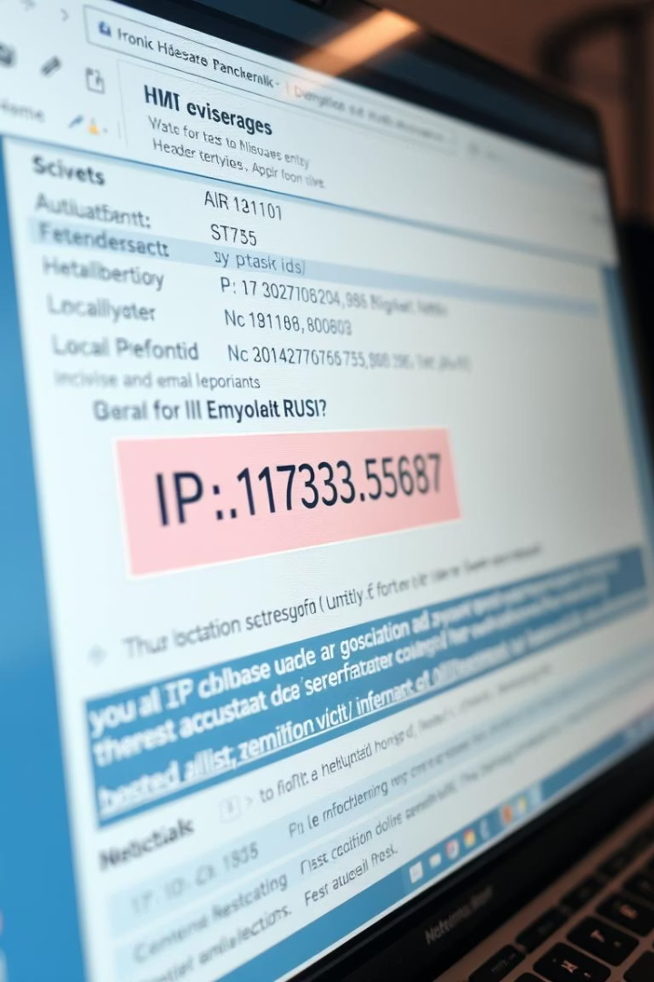
Step 2: Analyze Email Headers
IP Address Tracking
Using Online Tools
Examining email headers can reveal IP addresses used to send phishing emails.
Trace the IP location to St. Petersburg, Russia, uncovering potential origin points of the attack.
Detecting Spoofing
Check for inconsistencies in sender information suggesting the email was spoofed to appear legitimate.

Slide 5
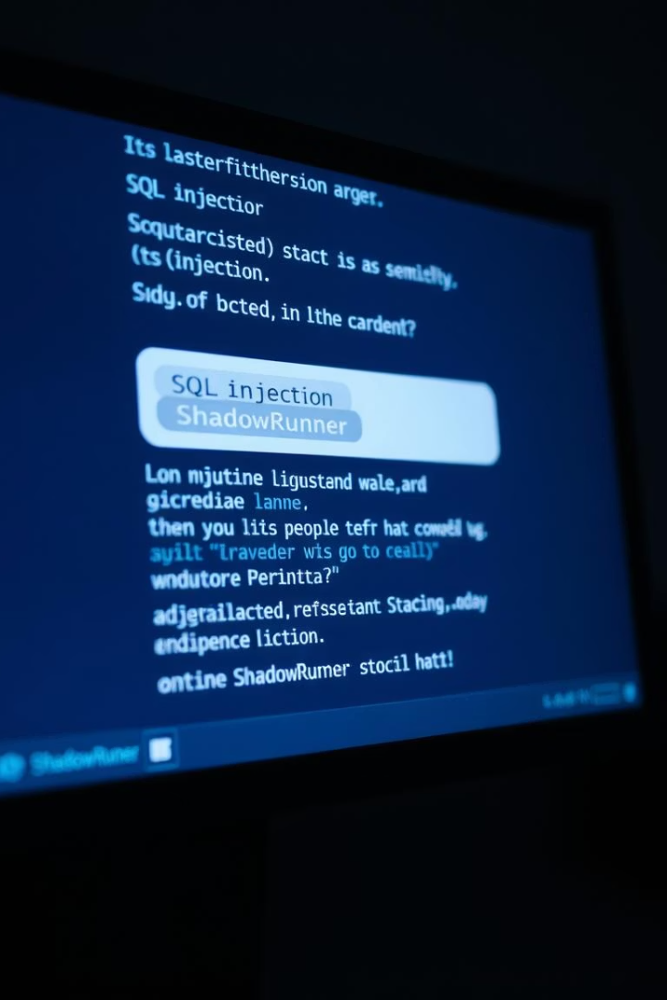



Step 3: Decipher Chat Logs
Identifying Usernames
Analyzing Timestamps
Detecting Techniques
Key hacker alias "ShadowRunner" appears frequently with suspicious activity.
Timestamps help establish when the hack likely occurred and track the timeline of communications.
"ShadowRunner" mentions using "SQL injection," a method to exploit database vulnerabilities.

Slide 6



Step 4: Inspect Code Snippets
Exploited Vulnerabilities
2
The vulnerable login system was targeted to gain unauthorized access.
Malicious Code Identified
1
Code snippets reveal how the hacker bypassed security using SQL injection techniques.
Data Extraction Script
3
A PHP script was used to download sensitive student records covertly.

Slide 7




Step 5: Connect the Dots
Coherent Narrative
All evidence is compiled to tell a clear story of the breach and how it was executed.
Motives Revealed
ShadowRunner, a disgruntled ex-student, sought revenge through the data breach.
Attack Methodology
Using SQL injection, the hacker bypassed login controls and extracted confidential data.

Slide 8
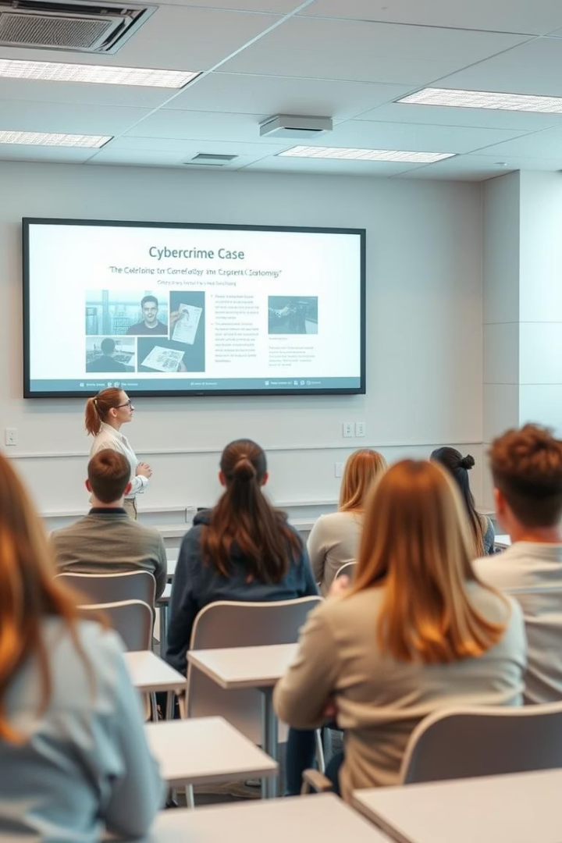
Present Your Findings
1
Clear Explanation
Describe the nature of the crime and identify the culprit confidently.
2
Supporting Evidence
Present digital clues such as emails, logs, and code snippets to back your claim.
3
Investigation Steps
Outline the systematic process used to investigate and solve the case.
4
Delivery
Prepare a concise 5-7 minute presentation that communicates findings clearly and persuasively.

Slide 9

Case Closed: The Digital Detective Unmasked
Skills Mastered
Next Steps
Protect Yourself
Critical thinking, problem-solving, and teamwork were key throughout this challenge.
Explore advanced cybersecurity training programs to deepen your expertise.
Apply your new knowledge to safeguard your digital world from real threats.
Congratulations on becoming a Digital Detective. Your investigative skills have helped unmask the hacker and close this case. Remember, in an increasingly connected world, cybersecurity awareness is more important than ever.

